Slide 1
Analysis of the Total Market General Infusion Pump data for the Job of Infusing Therapeutic Agents in a Hospital Setting
Analysis of nurse responses working with Adults & Paediatrics in the ICU, and Other Units

Slide 2
Respondent Demographics
 | Type of Nurse | # | %
S12b. Do you work on either a Medical-Surgical or in an Intensive Care Unit? If yes, which one? If no, indicate the unit in which you work. | Medical-Surgical – Adult | 124 | 37.20%
 | Medical-Surgical – Pediatric | 20 | 6.00%
 | ICU – Adult | 145 | 43.50%
 | ICU – Pediatric | 13 | 3.90%
 | No, other | 31 | 9.30%
Nurses that responded as “Other”: 10 different units represented
ER – 7
Cardiac: telemetry, testing, ICU, interventional
Birthing center – 2
Inpatient dialysis
Inpatient oncology
Imaging – 2
NICU
Outpatient clinic
Progressive care

Slide 3
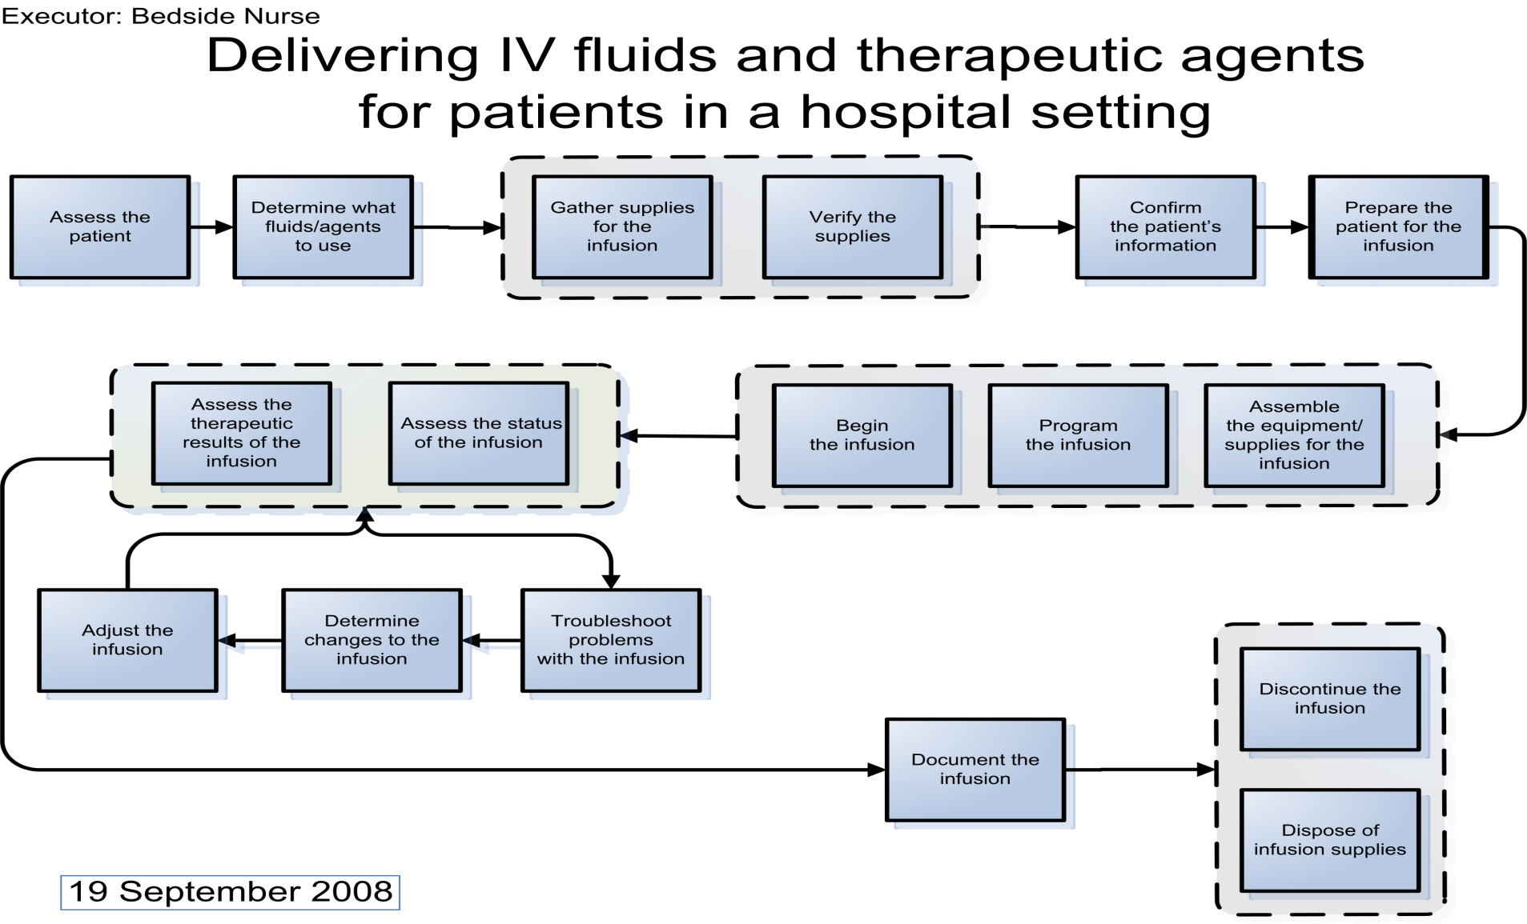
Total Market Opportunities Job Map

Slide 4
Step 1: Assess the Patient
Key Messages:
Pediatric nurses are especially concerned with minimizing trauma and/or adverse events for their patients. They are also very sensitive to the cycle time required to obtain information to assess whether the patient is responding to the therapy.
Extreme opportunity to ensure pediatric nurses have the alerts & available knowledge to determine if a given patient condition contraindicates the therapy.
Adult & pediatric nurses are both concerned with getting accurate data to assess patient needs.

Slide 5
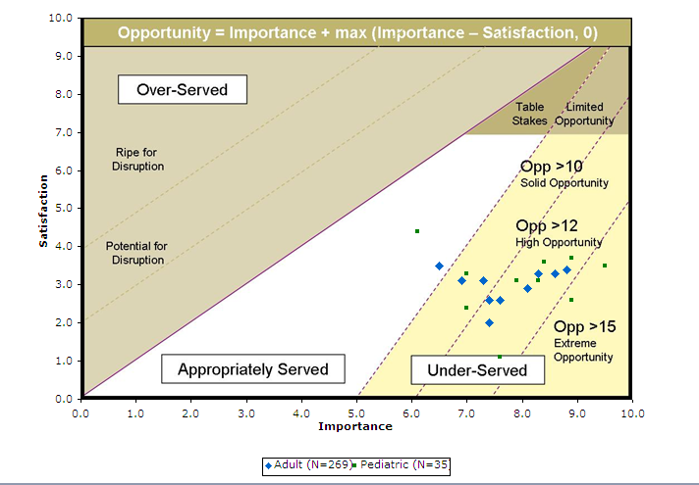
Step 1: Assess the Patient

Slide 6
Step 1: Assess the Patient
 | Adult (N=269) |  |  | Pediatric (N=35)
Outcomes | I | S | O | I | S | O
Minimize the likelihood that the determination of need is made incorrectly, e.g., due to incorrect lab results, incorrect interpretation, incorrect physical assessment, etc. | 8.8 | 3.4 | 14.2 | 9.5 | 3.5 | 15.5
Minimize the likelihood of being unaware of a patient condition that would contraindicate the administration of a specific fluid/agent. | 8.6 | 3.3 | 13.9 | 8.9 | 2.6 | 15.2
Minimize the amount of physical trauma to the patient when determining the need for infusion, e.g., pain, bruising, venous scarring, etc. | 8.3 | 3.3 | 13.3 | 8.9 | 3.7 | 14.1
Minimize the time required to obtain the results of measures used to determine the patient's need for infusion therapy, e.g., lab results, x-ray results, patient weight, etc. | 8.1 | 2.9 | 13.3 | 7.6 | 1.1 | 14.1
Minimize the likelihood that a measure required for the determination of the need for infusion therapy cannot be obtained | 7.4 | 2.0 | 12.8 | 8.3 | 3.1 | 13.5
Increase the likelihood of knowing whether key measures have been conducted, e.g., lab results, test results, etc. | 7.6 | 2.6 | 12.6 | 8.4 | 3.6 | 13.2
Minimize the time to obtain samples for lab measurements. | 7.4 | 2.6 | 12.2 | 7.9 | 3.1 | 12.7
Minimize the time required to determine if the patient's symptoms can be treated with infusion therapy, e.g., by reviewing their chart, previous infusions, the orders, medication guidelines, etc. | 7.3 | 3.1 | 11.5 | 7.0 | 2.4 | 11.6
Minimize the amount of variability in time that it takes to obtain the results of measures used to determine the patient's need for infusion therapy. | 6.9 | 3.1 | 10.7 | 7.0 | 3.3 | 10.7
Minimize the time required to assess the patient's condition when the responsibility for their care has been transferred, e.g., from shift to shift, ward to ward, hospital to hospital, etc. | 6.5 | 3.5 | 9.5 | 6.1 | 4.4 | 7.8

Slide 7
Step 2: Determine what Fluids/Agents to Use
Key Messages:
Access to timely data about drugs, patient labs, and timing for therapy is an extreme opportunity for nurses in Adult & Pediatric hospital units to they avoid:
Avoid adverse reactions due to unnecessary or inappropriate therapy.
Don’t miss therapy when it’s scheduled to be delivered
Exacerbate a patient condition.
Ability to make timely decisions to assess the impact of a given therapy on a patient is also significant opportunity for nurses in Adult hospital units.

Slide 8
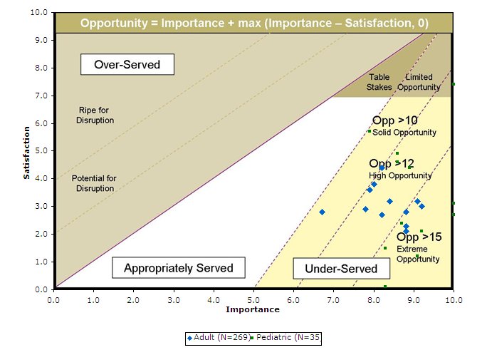
Step 2: Determine what Fluids/Agents to Use

Slide 9
Step 2: Determine what Fluids/Agents to Use
 | Adult (N=269) |  |  | Pediatric (N=35)
Outcomes | I | S | O | I | S | O
Minimize the time required to determine if a prescribed fluid/agent will exacerbate a patient condition, e.g., renal failure, liver failure, etc. | 8.8 | 2.1 | 15.5 | 10.0 | 2.7 | 17.3
Minimize the likelihood of infusing an agent that is inappropriate based on the patient's lab results, e.g., K+ for patient with high potassium. | 9.2 | 3.0 | 15.4 | 9.1 | 1.2 | 17.0
Minimize the likelihood that the fluids/agents chosen cause an adverse reaction. | 8.8 | 2.3 | 15.3 | 10.0 | 3.1 | 16.9
Minimize the likelihood of delivering a fluid/agent to a patient when they do not need it, e.g., when contraindicated, when inappropriate based on a lab test, etc. | 9.1 | 3.2 | 15.0 | 8.3 | 0.1 | 16.5
Minimize the time required to determine if a proposed infusion therapy will cause an adverse reaction in a patient. | 8.8 | 2.8 | 14.8 | 9.2 | 2.1 | 16.3
Minimize the likelihood of missing or delaying an order for infusion therapy, e.g., not including a specific medication, not starting at a specified time, etc. | 8.2 | 2.7 | 13.7 | 8.3 | 1.5 | 15.1
Minimize the time required to find an alternative to a prescribed fluid/agent, e.g., because it is not available, because it is contraindicated for use with another fluid/agent, etc. | 8.4 | 3.2 | 13.6 | 8.7 | 2.4 | 15.0

Slide 10
Step 2: Determine what Fluids/Agents to Use
 | Adult (N=269) |  |  | Pediatric (N=35)
Outcomes | I | S | O | I | S | O
Minimize the time to get the order for a fluid/agent. | 7.8 | 2.9 | 12.7 | 8.9 | 4.4 | 13.4
Minimize the time required to determine how a prescribed fluid/agent must be infused. | 8.0 | 3.8 | 12.2 | 10.0 | 7.4 | 12.6
Minimize the time required to determine an optimal medication administration schedule for the patient's infusion therapy when the therapy is being started. | 7.9 | 3.6 | 12.2 | 8.6 | 4.6 | 12.6
Increase the likelihood of complying with hospital protocols for infusion therapy. | 8.2 | 4.4 | 12.0 | 8.6 | 4.9 | 12.3
Minimize the time required to determine how a proposed infusion therapy will benefit a patient. | 6.7 | 2.8 | 10.6 | 7.9 | 5.7 | 10.1

Slide 11
Step 3: Gather supplies
Key Messages:
Nurses in Pediatric hospital units have higher opportunities than nurses in Adult hospital units in the following areas:
Avoiding exposure to hazardous materials for all parties (practitioners & patients) [Significant Opportunity]
Sourcing the right materials (equipments & drugs)
Turnaround time to obtain the right materials

Slide 12
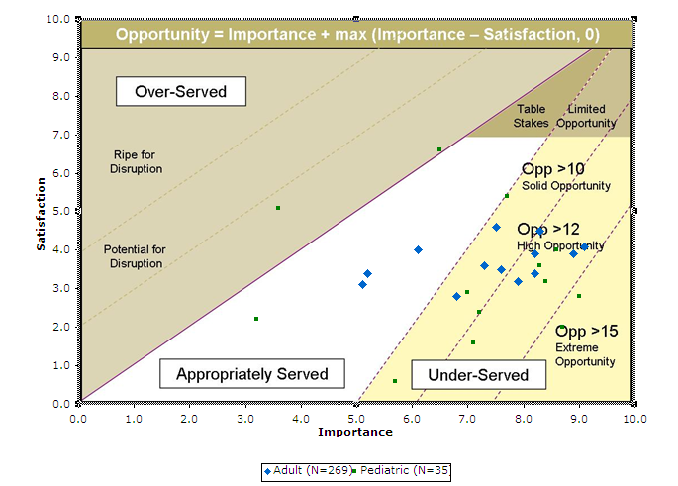
Step 3: Gather supplies

Slide 13
Step 3: Gather supplies
 | Adult (N=269) |  |  | Pediatric (N=35)
Outcomes | I | S | O | I | S | O
Minimize the likelihood of gathering the wrong fluid/agent for a patient's order, e.g., wrong drug, wrong concentration, wrong amount, etc. | 9.1 | 4.1 | 14.1 | 8.7 | 2.0 | 15.4
Minimize the likelihood of exposure to biohazardous materials for all individuals while gathering supplies. | 8.9 | 3.9 | 13.9 | 9.0 | 2.8 | 15.2
Minimize the likelihood that the needed fluids/agents are not available, e.g., D5/W, Ampicillan, etc. | 8.2 | 3.4 | 13.0 | 8.4 | 3.2 | 13.6
Minimize the time required to obtain fluids/agents that are custom formulations needed for the infusion therapy. | 7.9 | 3.2 | 12.6 | 8.6 | 4.0 | 13.2
Minimize the time required to obtain the fluids/agents needed for the infusion therapy, e.g., medications, hydration fluids, chemotherapy agents, etc. | 8.2 | 3.9 | 12.5 | 8.3 | 3.6 | 13.0
Minimize the likelihood that the needed equipment/supplies are not available, e.g., infusion device, tubing, etc. | 8.3 | 4.5 | 12.1 | 7.1 | 1.6 | 12.6

Slide 14
Step 3: Gather supplies
 | Adult (N=269) |  |  | Pediatric (N=35)
Outcomes | I | S | O | I | S | O
Minimize the time required to obtain fluids/agents that are controlled substances needed for the infusion therapy, e.g., narcotics, paralytics, etc. | 7.6 | 3.5 | 11.7 | 7.2 | 2.4 | 12.0
Minimize the time required to obtain the equipment/supplies needed for the infusion therapy, e.g., infusion device, tubing, etc. | 7.3 | 3.6 | 11.0 | 7.0 | 2.9 | 11.1
Minimize the time required to determine when an ordered fluid/agent will be received. | 6.8 | 2.8 | 10.8 | 5.7 | 0.6 | 10.8
Minimize the likelihood of choosing the wrong equipment or supplies for the desired fluids/therapy | 7.5 | 4.6 | 10.4 | 7.7 | 5.4 | 10.0
Minimize the time required to move supplies/equipment, from source of the supplies/equipment to patient's room. | 6.1 | 4.0 | 8.2 | 6.5 | 6.6 | 6.5
Minimize the amount of storage space the supplies/equipment occupy in a patient's room. | 5.1 | 3.1 | 7.1 | 3.2 | 2.2 | 4.2
Minimize the time to open all the packages, e.g., tubing, connectors, etc. | 5.2 | 3.4 | 7.0 | 3.6 | 5.1 | 3.6

Slide 15
Step 4: Verify the supplies
Key Messages:
Nurses in both Adult & Pediatric hospital units both struggle with having access to the right knowledge about the materials gathered for preparing the therapy to avoid adverse events. [Significant opportunities]
Nurses in Pediatric hospital units have a much higher level of concern than nurses in Adult hospital units to:
Resolve a problem with supplies in a timely manner
Determine compatibility of supplies in a timely manner
[Significant opportunity for Peds]

Slide 16
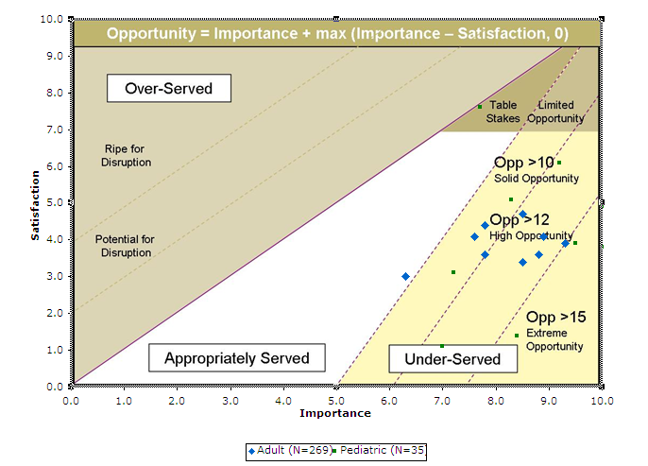
Step 4: Verify the supplies

Slide 17
Step 4: Verify the supplies
 | Adult (N=269) |  |  | Pediatric (N=35)
Outcomes | I | S | O | I | S | O
Minimize the likelihood that fluids/agents are mislabeled due to nurse or pharmacist error, e.g., with the wrong name, concentration, patient ID, etc. | 9.3 | 3.9 | 14.7 | 10.0 | 3.8 | 16.2
Minimize the likelihood of causing an adverse reaction due to not knowing pharmaceutical information, e.g., the drug is a derivative of another drug, drug-drug interactions, etc. | 8.8 | 3.6 | 14.0 | 8.4 | 1.4 | 15.4
Minimize the likelihood of making an error when confirming the attributes of a new fluid/agent to be infused, e.g., misreading, misunderstanding, etc. | 8.9 | 4.1 | 13.7 | 10.0 | 4.9 | 15.1
Minimize the likelihood of using a fluid/agent that is not included in an order, e.g., due to incorrectly anticipating, misunderstanding, etc. | 8.5 | 3.4 | 13.6 | 9.5 | 3.9 | 15.1
Minimize the likelihood that the equipment/supplies are mislabeled, e.g., a pump, tubing, etc. | 8.5 | 4.7 | 12.3 | 7.0 | 1.1 | 12.9
Minimize the time required to resolve a problem with incorrect supplies e.g., an incorrect fluid, piece of equipment, etc. | 7.8 | 3.6 | 12.0 | 9.2 | 6.1 | 12.3
Minimize the likelihood that the equipment/supplies are not compatible with each other, e.g., one piece does not fit another, etc. | 7.8 | 4.4 | 11.2 | 8.3 | 5.1 | 11.5
Minimize the time required to verify that the equipment/supplies are compatible with the fluids/therapy to be delivered. | 7.6 | 4.1 | 11.1 | 7.2 | 3.1 | 11.3
Minimize the likelihood that supplies expire before the patient is ready for the infusion e.g.,supplies gathered or opened too early, etc. | 6.3 | 3.0 | 9.6 | 7.7 | 7.6 | 7.8

Slide 18
Step 5: Confirm the patient’s information
Key Messages:
Availability of knowledge regarding patient allergies, medications being taken by a patient, vital signs and labs are extreme opportunities for nurses in both Adult & Pediatrics hospital units.
There is also an important opportunity to identify conflicts with information from multiple sources as well as the drugs themselves. Nurses in Adult units have a higher need than nurses in Pediatric units.
Timely access to information is also important to reduce the time required for decisions. Higher need for nurses in Adult units than nurses in Pediatric units.

Slide 19
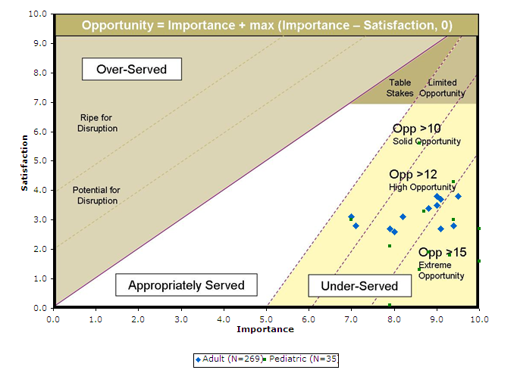
Step 5: Confirm the patient’s information

Slide 20
Step 5: Confirm the patient’s information
 | Adult (N=269) |  |  | Pediatric (N=35)
Outcomes | I | S | O | I | S | O
Minimize the likelihood of giving a patient a medication to which they are allergic. | 9.4 | 2.8 | 16.0 | 10.0 | 1.6 | 18.4
Minimize the likelihood that information from different sources conflict, e.g., allergies, tolerances, etc. | 9.1 | 2.7 | 15.5 | 10.0 | 2.7 | 17.3
Minimize the likelihood of a medication error due to incomplete knowledge of all the medications and fluids that a patient is being given. | 9.5 | 3.8 | 15.2 | 9.3 | 1.8 | 16.8
Minimize the likelihood that there are adverse events due to an interaction between the medication and another patient attribute, e.g., with other disease states, other medications, etc. | 9.0 | 3.5 | 14.5 | 8.6 | 1.3 | 15.9
Minimize the time required to verify that the fluids/agents obtained are correct according to five rights of medication administration | 9.1 | 3.7 | 14.5 | 9.4 | 3.0 | 15.8
Minimize the time required to verify that the fluids/agents obtained remain correct according to five rights of medication administration when care is transferred to another shift | 9.0 | 3.8 | 14.2 | 8.8 | 1.9 | 15.7

Slide 21
Step 5: Confirm the patient’s information
 | Adult (N=269) |  |  | Pediatric (N=35)
Outcomes | I | S | O | I | S | O
Minimize the likelihood that a drug is given without having the vital signs checked when these are critical to the infusion therapy, e.g., cardio-active or anesthesia medications. | 8.8 | 3.4 | 14.2 | 7.9 | 0.1 | 15.7
Minimize the time to reconcile the information about all of the patient's medications when the responsibility for their care is changing, e.g., discharge, ward transfer, etc. | 8.0 | 2.6 | 13.4 | 9.4 | 4.3 | 14.5
Minimize the likelihood that a drug is given without having the lab results checked when these are critical to the infusion therapy. | 8.2 | 3.1 | 13.3 | 8.7 | 3.3 | 14.1
Minimize the time to resolve questions about an infusion order. | 7.9 | 2.7 | 13.1 | 7.9 | 2.1 | 13.7
Minimize the time required to confirm historical patient information that will affect infusion therapy, e.g., previous infusions, allergies, etc. | 7.1 | 2.8 | 11.4 | 8.6 | 5.6 | 11.6
Minimize the time required to confirm the patient information that will affect the infusion therapy, e.g., weight, vital signs, identity, etc. | 7.0 | 3.1 | 10.9 | 7.0 | 3.0 | 11.0

Slide 22
Step 6: Prepare the patient for the infusion
Key Messages:
Both nursing units struggle with targeting access to veins, finding enough access sites, and gaining access in difficult to access veins.
Both nursing units are very sensitive to avoiding pain, tissue trauma or other adverse events to the patients while avoiding exposure to biohazardous materials.
Nurses in Pediatric units represent a consistently higher opportunity than nurses in Adult units. Both represent significant to extreme opportunities.

Slide 23
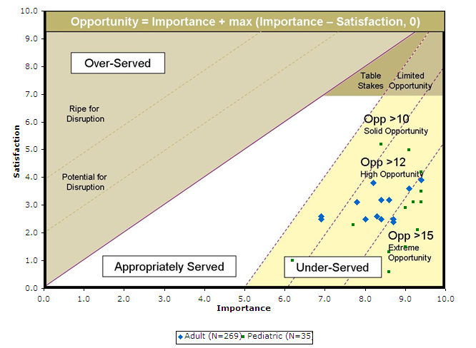
Step 6: Prepare the patient for the infusion

Slide 24
Step 6: Prepare the patient for the infusion
 | Adult (N=269) |  |  | Pediatric (N=35)
Outcomes | I | S | O | I | S | O
Minimize the number of access sites needed to deliver a patient's IV therapy. | 8.7 | 2.4 | 15.0 | 8.6 | 0.6 | 16.6
Minimize the time required to gain intravenous access in a patient with difficult to access veins, e.g., diabetics, elderly patients, small children, etc. | 8.7 | 2.5 | 14.9 | 9.3 | 2.1 | 16.5
Minimize the likelihood that the nurse becomes infected with a biohazardous agent when gaining access to the patient's circulatory system. | 9.4 | 3.9 | 14.9 | 9.0 | 1.5 | 16.5
Minimize the likelihood of causing an adverse effect when gaining access to the patient's circulatory system, .e.g., an infection, nerve damage, blood clots, etc. | 9.1 | 3.6 | 14.6 | 8.6 | 1.3 | 15.9
Minimize the amount of pain the patient experiences when gaining access to their circulatory system. | 8.4 | 2.5 | 14.3 | 9.4 | 3.1 | 15.7
Minimize the likelihood of causing trauma to the tissues around the access site for infusion therapy due to needle sticks, etc. | 8.6 | 3.2 | 14.0 | 9.4 | 3.5 | 15.3
Minimize the likelihood that a vein cannot be found which will support the prescribed infusion therapy | 8.3 | 2.6 | 14.0 | 9.2 | 3.1 | 15.3

Slide 25
Step 6: Prepare the patient for the infusion
 | Adult (N=269) |  |  | Pediatric (N=35)
Outcomes | I | S | O | I | S | O
Minimize the number of access sites needed to deliver a patient's IV therapy. | 8.7 | 2.4 | 15.0 | 8.6 | 0.6 | 16.6
Minimize the likelihood that movement of the patient can interrupt the infusion therapy, e.g., by the patient, a nurse, a visitor, etc. | 8.4 | 3.2 | 13.6 | 9.0 | 2.9 | 15.1
Minimize the time required to determine what access site to use to add another fluid/agent to an existing infusion therapy, e.g., which vein, at what level, etc. | 8.0 | 2.5 | 13.5 | 9.4 | 4.2 | 14.6
Minimize the likelihood that the required rate for a fluid/agent cannot be achieved with the access site, e.g., due to too small a catheter, inadequate tubing, etc. | 8.2 | 3.8 | 12.6 | 9.1 | 5.0 | 13.2
Minimize the likelihood of removing a catheter at the end of a prescribed infusion when it may be required for a future infusion during the current hospital stay. | 7.8 | 3.1 | 12.5 | 7.7 | 2.3 | 13.1
Minimize the time required to determine which vein will support the prescribed infusion therapy, e.g., is large enough, is accessible, is patent, etc. | 6.9 | 2.5 | 11.3 | 8.4 | 5.2 | 11.6
Minimize the likelihood that the start of infusion therapy is delayed because of a need to attend directly to a patient's needs, e.g., due to bleeding, retching, mobility, etc. | 6.9 | 2.6 | 11.2 | 6.2 | 1.0 | 11.4

Slide 26
Step 7: Assemble the equipment
Key Messages:
Nurses in both Adult & Pediatric units had consistent needs to address the following:
Minimize the waste of space, time, and effort in assembling equipment
Avoiding adverse events
Avoiding errors with the assembly process
Avoiding waste of materials
There were also opportunities to improve the reliability, readiness, and resiliency of the equipment (esp. during transitions, hand-offs, and when mobilizing patients to avoid disruption in therapy).

Slide 27
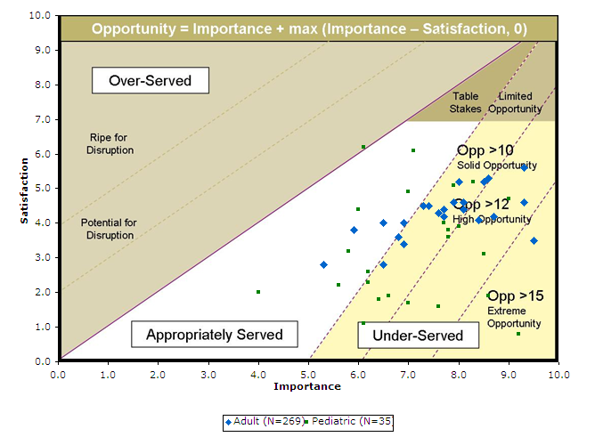
Step 7: Assemble the equipment

Slide 28
Step 7: Assemble the equipment
 | Adult (N=269) |  |  | Pediatric (N=35)
Outcomes | I | S | O | I | S | O
Minimize the likelihood of introducing incompatible fluids/agents into the same line. | 9.5 | 3.5 | 15.5 | 9.2 | 0.8 | 17.6
Minimize the time required to start infusion therapy for patients in a critical status. | 9.3 | 4.6 | 14.0 | 8.6 | 1.9 | 15.3
Minimize the likelihood of making an error assembling infusion components when multiple infusion devices are being used. | 8.7 | 4.2 | 13.2 | 8.5 | 3.1 | 13.9
Minimize the likelihood that an air embolism is introduced into the patient's circulatory system when assembling the equipment/supplies. | 9.3 | 5.6 | 13.0 | 7.6 | 1.6 | 13.6
Minimize the likelihood of injuring any person with infusion equipment during transport, e.g., due to tipping or falling equipment, the tubing being pulled out, etc. | 8.4 | 4.1 | 12.7 | 9.0 | 4.7 | 13.3
Minimize the risk that the nurse is injured when assembling the equipment/supplies, e.g., is cut or punctured, burned by caustic fluids, injured when opening packages, etc. | 8.6 | 5.3 | 11.9 | 7.0 | 1.7 | 12.3

Slide 29
Step 7: Assemble the equipment
 | Adult (N=269) |  |  | Pediatric (N=35)
Outcomes | I | S | O | I | S | O
Minimize the time required to verify that the equipment/supplies are prepared correctly, e.g., they are assembled, connected, etc. | 8.1 | 4.4 | 11.8 | 8.0 | 3.9 | 12.1
Minimize the likelihood of making an error when using unfamiliar equipment/supplies. | 8.5 | 5.2 | 11.8 | 7.8 | 3.6 | 12.0
Minimize the likelihood that infusion therapy is delayed due to unreliable pump components, e.g., they are worn or broken, or have unclear labels, etc. | 8.1 | 4.6 | 11.6 | 7.8 | 3.8 | 11.8
Minimize the time required to prepare the equipment/supplies for an infusion therapy composed of multiple fluids/agents. | 7.9 | 4.6 | 11.2 | 7.7 | 4.0 | 11.4
Minimize the likelihood that a patient does not receive all of a required dose due to waste incurred when assembling the equipment/supplies, e.g., due to priming, spills, etc. | 7.9 | 4.6 | 11.2 | 8.3 | 5.2 | 11.4
Minimize the likelihood that therapy is interrupted because unintended movement of the equipment/supplies interferes with infusion therapy, e.g., it falls, moves down the pole, etc. | 7.7 | 4.2 | 11.2 | 6.6 | 1.9 | 11.3
Minimize the likelihood of injuring any person with the infusion equipment, e.g., due to tipping or falling equipment, the tubing being pulled out, etc. | 7.7 | 4.4 | 11.0 | 6.1 | 1.1 | 11.1

Slide 30
Step 7: Assemble the equipment
 | Adult (N=269) |  |  | Pediatric (N=35)
Outcomes | I | S | O | I | S | O
Minimize the likelihood that supplies are not ready for use, e.g., tubing is tangled, needles are not sterile, etc. | 7.6 | 4.3 | 10.9 | 6.4 | 1.8 | 11.0
Minimize the likelihood of making an error when assembling infusion components, e.g., using a wrong connector for the IV tubing. | 8.0 | 5.2 | 10.8 | 7.9 | 5.1 | 10.7
Minimize the likelihood that equipment is not ready for use, e.g., inadequate power, not clean, etc. | 6.9 | 3.4 | 10.4 | 6.2 | 2.3 | 10.1
Minimize the time required to prepare the equipment/supplies for an infusion therapy when multiple infusion devices are being used. | 7.4 | 4.5 | 10.3 | 6.2 | 2.6 | 9.8
Minimize the amount of space taken up in the patient's room by the equipment/supplies needed for infusion therapy. | 6.5 | 2.8 | 10.2 | 7.0 | 4.9 | 9.1
Minimize the likelihood of interrupting the infusion when transporting the patient. | 7.3 | 4.5 | 10.1 | 5.6 | 2.2 | 9.0
Minimize the time required to determine if equipment is ready for use, e.g., has power, has current maintenance, is clean, etc. | 6.8 | 3.6 | 10.0 | 5.8 | 3.2 | 8.4

Slide 31
Step 7: Assemble the equipment
 | Med-Surge N = 156 |  |  | ICU N = 149 |  |  | Other N = 31
Outcome | I | S | O | I | S | O | I | S | O | Theme
Minimize the amount of space taken up in the patient's room by the equipment/supplies needed for infusion therapy. | 5.3 | 3.4 | 7.2 | 7.3 | 2.5 | 12.1 | 6.1 | 3.0 | 9.2
Minimize the time required to prime a pump administration set. | 6.3 | 4.0 | 8.6 | 7.2 | 4.2 | 10.2 | 6.2 | 4.5 | 7.9
Minimize the time required to switch infusion equipment when transferring a patient from one unit to another. | 6.6 | 4.6 | 8.6 | 6.2 | 3.5 | 8.9 | 5.4 | 2.0 | 8.8
Minimize the amount of fatigue the nurse experiences when assembling equipment/supplies, e.g., due to weight, force, repetitive actions, etc. | 6.4 | 4.6 | 8.2 | 5.6 | 3.7 | 7.5 | 8.1 | 4.8 | 11.4
Minimize the likelihood that there is a restriction on patient mobility due to the infusion equipment/supplies. | 6.5 | 3.0 | 10.0 | 4.2 | 2.2 | 6.2 | 5.3 | 2.2 | 8.4

Slide 32
Step 8: Program the infusion
Key Messages:
Extreme opportunity with nurses in Pediatric units to minimize the amount of time to verify the 5 rights (to avoid adverse events)
Significant opportunities exist with nurses getting timely alerts and having information available to prevent errors from occurring.
Conservation of time is an important need for nurses to :
Gain access to information
Calculate dosages
Make any adjustments
Setup multiple infusion devices
Verify the therapy is setup accurately

Slide 33
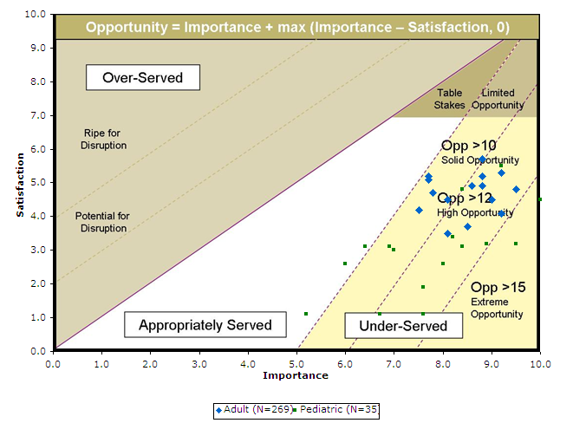
Step 8: Program the infusion

Slide 34
Step 8: Program the infusion
 | Adult (N=269) |  |  | Pediatric (N=35)
Outcomes | I | S | O | I | S | O
Minimize the time required to calculate a dose for a patient's infusion therapy, e.g., a non-standard one, one that is outside of protocol, etc. | 9.2 | 4.1 | 14.3 | 9.5 | 3.2 | 15.8
Increase the likelihood of being informed of a programming error, e.g., in dosage, flow rate, etc. | 9.5 | 4.8 | 14.2 | 10.0 | 4.5 | 15.5
Minimize the likelihood that the incorrect flow rate is being given to patients who are sensitive to the volume of fluid infused. | 9.0 | 4.5 | 13.5 | 8.9 | 3.2 | 14.6
Minimize the time required to prevent the inappropriate administration of medication because the checks on medication identity, dosage or concentration are unavailable. | 8.5 | 3.7 | 13.3 | 7.6 | 1.1 | 14.1
Minimize the likelihood of making an error when calculating doses/rates | 9.2 | 5.3 | 13.1 | 8.4 | 3.1 | 13.7
Minimize the likelihood that settings from one infusion therapy session unintentionally influences a new infusion therapy session, e.g., dosage, alarm settings, limits, etc. | 8.8 | 4.9 | 12.7 | 8.0 | 2.6 | 13.4
Minimize the likelihood of starting a fluid/agent at the wrong time, e.g., off-schedule, too early, too late, etc. | 8.1 | 3.5 | 12.7 | 7.6 | 1.9 | 13.3

Slide 35
Step 8: Program the infusion
 | Adult (N=269) |  |  | Pediatric (N=35)
Outcomes | I | S | O | I | S | O
Minimize the time required to calculate the rate of fluid/agent delivery in order to achieve the prescribed dosage. | 8.8 | 5.2 | 12.4 | 8.2 | 3.4 | 13.0
Minimize the time required to program the infusion devices when a patient needs multiple infusion devices. | 8.6 | 4.9 | 12.3 | 9.2 | 5.5 | 12.9
Minimize the time required to adjust the delivery program for an infusion, e.g. rate, volume etc. | 8.8 | 5.7 | 11.9 | 6.7 | 1.1 | 12.3
Minimize the time required to reprogram the infusion device when information is lost, e.g., due to power loss, pump failure, etc. | 8.1 | 4.5 | 11.7 | 8.4 | 4.8 | 12.0
Minimize the time required to convert the infusion therapy from one medication concentration to another, e.g., when the patient is transferred from another ward, when orders change, etc. | 7.8 | 4.7 | 10.9 | 7.0 | 3.0 | 11.0
Minimize the likelihood that data must be entered more than one time during programming, e.g., patient identity, weight, etc. | 7.5 | 4.2 | 10.8 | 6.9 | 3.1 | 10.7
Minimize the time required to set up the correct volume to be infused on the infusion device when an additional volume must be added to ensure that all of the therapeutic agent is infused. | 7.7 | 5.1 | 10.3 | 6.4 | 3.1 | 9.7
Minimize the time required to verify the programming of the infusion therapy. | 7.7 | 5.2 | 10.2 | 6.0 | 2.6 | 9.4
Minimize the time required to change the dosing schedule when programming the infusion device. | 7.7 | 5.2 | 10.2 | 5.2 | 1.1 | 9.3

Slide 36
Step 9: Begin the infusion
Key Messages:
Time lag to initiate therapy is an issue during emergency situations
Patient risk (trauma, discomfort) are important for all nurses
Information availability and awareness (via alerts) is a significant concern for all nurses
Exposure is a consistently high concern amongst the nurses

Slide 37
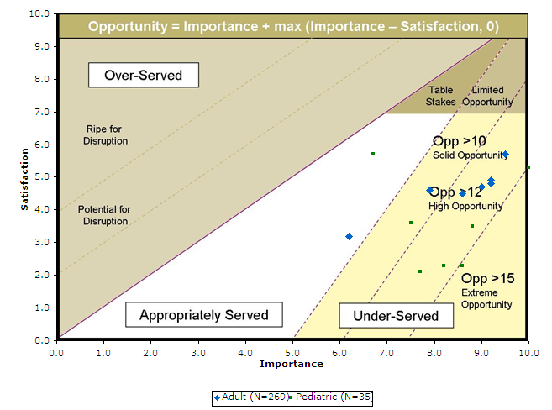
Step 9: Begin the infusion

Slide 38
Step 9: Begin the infusion
 | Adult (N=269) |  |  | Pediatric (N=35)
Outcomes | I | S | O | I | S | O
Minimize the likelihood of infection while fluids/agents are being delivered. | 9.2 | 4.8 | 13.6 | 8.6 | 2.3 | 14.9
Minimize the time required for fluids/agents to start flowing into the patient's circulatory system in an emergency situation. | 9.2 | 4.9 | 13.5 | 10.0 | 5.3 | 14.7
Increase the likelihood of being aware that infusion is not flowing. | 9.5 | 5.7 | 13.3 | 8.8 | 3.5 | 14.1
Minimize the likelihood of exposure to dangerous materials for all individuals when beginning the infusion, e.g., biohazardous, oncolytic. | 9.0 | 4.7 | 13.3 | 8.2 | 2.3 | 14.1
Minimize the amount of discomfort the patient experiences when beginning the infusion, e.g., pressure, burning, itching, etc. | 8.6 | 4.5 | 12.7 | 7.7 | 2.1 | 13.3
Minimize the time required for fluids/agents to start flowing into the patient's circulatory system. | 7.9 | 4.6 | 11.2 | 7.5 | 3.6 | 11.4
Minimize the amount of annoyance caused to the patient by sounds of the infusion equipment. | 6.2 | 3.2 | 9.2 | 6.7 | 5.7 | 7.7

Slide 39
Step 10: Assess the status of the infusion
Key Messages:
The time required to assess, decide, and take corrective action to prevent/mitigate adverse reaction is a common theme for all nurses.
Avoiding situations that lead to adverse events is an extreme opportunity for all nurses.
The timeliness and awareness of information (alerts) are critical factors for assessment. Information availability, insights & accuracy are critical for guiding timely decisions [significant to extreme opportunity for nurses in Pediatric units]
Avoiding disruption in therapy is an important opportunity to improve the resiliency of the equipment (esp. when power is not available, transitions or occlusion in the tube to avoid disruption in therapy).

Slide 40
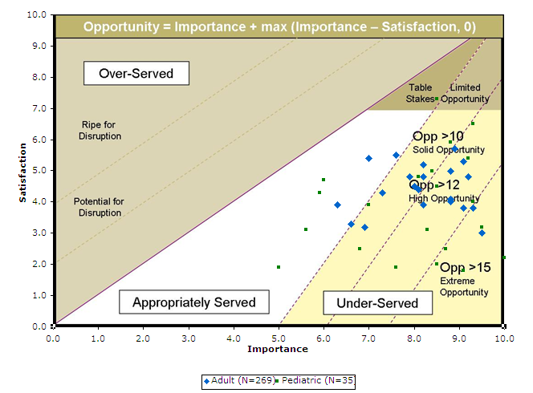
Step 10: Assess the status of the infusion

Slide 41
Step 10: Assess the status of the infusion
 | Adult (N=269) |  |  | Pediatric (N=35)
Outcomes | I | S | O | I | S | O
Minimize the risk of not being notified that the patient is having an adverse reaction to the infusion therapy, e.g., analyphylaxis, pain, etc. | 9.5 | 3.0 | 16.0 | 10.0 | 2.2 | 17.8
Minimize the time to detect infiltration. | 9.3 | 3.8 | 14.8 | 9.1 | 1.8 | 16.4
Minimize the likelihood of having an adverse reaction at the IV access site, e.g., due to the equipment, fluids, etc. | 9.1 | 3.8 | 14.4 | 9.5 | 3.2 | 15.8
Minimize the time required to become aware that there is a problem with infusion therapy, e.g., fluids are not infusing, fluids are infusing too fast or too slow, etc. | 9.2 | 4.8 | 13.6 | 8.5 | 2.0 | 15.0
Minimize the likelihood of interrupting an infusion, e.g., from an occlusion in the tubing due to a blood clot, or the catheter or needle comes out during delivery, or there is air in line. | 8.8 | 4.0 | 13.6 | 8.7 | 2.5 | 14.9
Minimize the likelihood that the infusion therapy is interrupted because the supply of fluids/agents is depleted, e.g., due to titration, flushing, etc. | 8.8 | 4.1 | 13.5 | 9.3 | 4.0 | 14.6
Minimize the likelihood that an infusion device reports inaccurate data, e.g., rate, volume, medication, etc. | 9.1 | 5.3 | 12.9 | 8.3 | 3.1 | 13.5

Slide 42
Step 10: Assess the status of the infusion
 | Adult (N=269) |  |  | Pediatric (N=35)
Outcomes | I | S | O | I | S | O
Minimize the time required to find the source of an infusion alarm when multiple infusions are running. | 8.8 | 5.0 | 12.6 | 7.6 | 1.9 | 13.3
Minimize the likelihood of an adverse reaction due to the equipment/supplies used, e.g., tubing, tape, arm board | 8.2 | 3.9 | 12.5 | 9.2 | 5.4 | 13.0
Minimize the likelihood of exceeding the prescribed hourly input. | 8.9 | 5.7 | 12.1 | 8.5 | 4.5 | 12.5
Minimize the time required to determine when a supply will need to be refreshed, e.g., to estimate when fluids will be depleted, when tubing will need to be replaced, etc. | 8.1 | 4.4 | 11.8 | 9.3 | 6.5 | 12.1
Minimize the likelihood of interrupting an infusion due to inadequate power, e.g., due to low batteries, an unplugged or unreliable device. | 8.2 | 4.8 | 11.6 | 8.4 | 5.0 | 11.8
Minimize the frequency with which an alarm situation is not addressed because the alarm is shut off inappropriately, e.g., by the patient, by a visitor, due to equipment failure, etc. | 8.0 | 4.5 | 11.5 | 8.8 | 5.9 | 11.7
Increase the likelihood that the prescribed amount of fluid/agent is completely delivered to the patient according to the desired schedule. | 8.2 | 5.2 | 11.2 | 8.1 | 4.8 | 11.4

Slide 43
Step 10: Assess the status of the infusion
 | Adult (N=269) |  |  | Pediatric (N=35)
Outcomes | I | S | O | I | S | O
Minimize the frequency with which a sleeping patient must be disturbed, e.g, to monitor the infusion therapy, to refresh supplies, etc. | 6.9 | 3.2 | 10.6 | 7.0 | 3.9 | 10.1
Minimize the time to determine the attributes of a patient's infusion therapy when transfer of care occurs, e.g., fluids/agents, supplies, equipment, rates, volumes, etc. | 7.3 | 4.3 | 10.3 | 8.5 | 7.3 | 9.7
Minimize the likelihood that the infusion therapies of multiple patients require attention at the same time. | 6.6 | 3.3 | 9.9 | 5.6 | 3.1 | 8.1
Minimize the time required to determine that the equipment is working properly, e.g., connections are good, power is sufficient, calibration is current, flow is normal, etc. | 7.6 | 5.5 | 9.7 | 5.0 | 1.9 | 8.1
Increase the likelihood of being notified that the fluid flow is as planned. | 6.3 | 3.9 | 8.7 | 5.9 | 4.3 | 7.5
Minimize the time required to determine when a volume of fluid/agent will be fully delivered. | 7.0 | 5.4 | 8.6 | 6.0 | 4.7 | 7.3

Slide 44
Step 11: Assess the therapeutic results of the infusion
Key Messages:
The time required to measure, capture & consume data to assess and decide on corrective action to prevent/mitigate adverse reaction is very important. Significant opportunity for Pediatric nurses.
Information availability, insights and accuracy are key factors for assessment and detection of adverse events. The opportunities range from significant to extreme, especially for Pediatric nurses.
One opportunity that has a heightened impact for Adult nurses concerns inaccurate patient data (due to confusion with another patient or that is simply incorrect vitals or lab data)

Slide 45
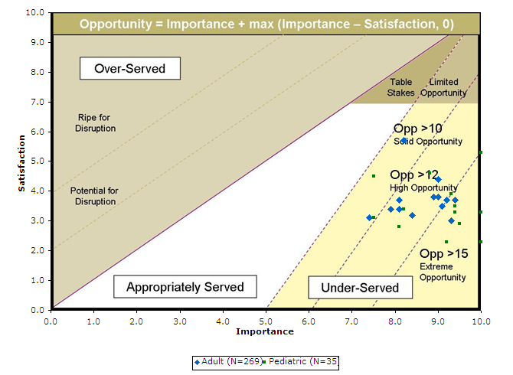
Step 11: Assess the therapeutic results of the infusion

Slide 46
Step 11: Assess the therapeutic results of the infusion
 | Adult (N=269) |  |  | Pediatric (N=35)
Outcomes | I | S | O | I | S | O
Minimize the likelihood that patient data are incorrect, e.g., blood pressure, heart rate, weight, lab results. | 9.3 | 3.0 | 15.6 | 10.0 | 2.3 | 17.7
Increase the likelihood of detecting respiratory depression when the patient has narcotics infused. | 9.4 | 3.7 | 15.1 | 10.0 | 3.3 | 16.7
Minimize the likelihood that results of one patient are confused with another. | 9.2 | 3.7 | 14.7 | 9.5 | 2.9 | 16.1
Minimize the likelihood that measurements from a patient are misidentified, e.g., a patient's, x-rays, vital signs, etc., are mixed up with another patient's. | 9.1 | 3.5 | 14.7 | 9.2 | 2.3 | 16.1
Increase the likelihood of detecting adverse reactions when the patient is sedated. | 9.0 | 3.8 | 14.2 | 9.4 | 3.3 | 15.5
Minimize the likelihood of continuing infusion therapy that is causing problems for the patient, e.g, fluid overload, anaphylaxis, incompatible fluids | 8.9 | 3.8 | 14.0 | 9.4 | 3.5 | 15.3
Minimize the time required to determine the benefit a patient receives from a change made to the infusion therapy, e.g., during titration, after a change in medications, etc. | 9.0 | 4.4 | 13.6 | 9.3 | 3.9 | 14.7

Slide 47
Step 11: Assess the therapeutic results of the infusion
 | Adult (N=269) |  |  | Pediatric (N=35)
Outcomes | I | S | O | I | S | O
Minimize the time required to perform the measurements needed to assess the results of the infusion therapy, e.g., cardiac output, lab values, x-rays, vital signs, Ins-and-Outs, etc. | 8.4 | 3.2 | 13.6 | 10.0 | 5.3 | 14.7
Minimize the time required to determine if the patient is getting a benefit from the infusion therapy. | 8.1 | 3.4 | 12.8 | 8.1 | 2.8 | 13.4
Minimize the time required to determine which metrics should be used to assess the results of the infusion therapy, e.g., which vital signs, what total dosage, what length of time, etc. | 8.1 | 3.7 | 12.5 | 8.2 | 3.4 | 13.0
Minimize the time required to gather all information about the patient's condition that is needed to make a decision about infusion therapy. | 7.9 | 3.4 | 12.4 | 8.8 | 4.6 | 13.0
Minimize the likelihood that the benefits of one fluid/agent cannot be determined due to effects of another fluid/agent. | 7.4 | 3.1 | 11.7 | 7.5 | 3.1 | 11.9
Minimize the time required to determine the how much of each fluid/agent has been infused into the patient. | 8.2 | 5.7 | 10.7 | 7.5 | 4.5 | 10.5

Slide 48
Step 12: Troubleshoot problems with the infusion
Key Messages:
Time required for root cause analysis is an extreme opportunity for nurses in Pediatric units.
Information awareness (alerts) and timeliness are very important factors for avoiding interruption of therapy and mitigating adverse reaction to patients. Significant opportunity for all nurses.
Secure access to equipment is a significant opportunity for nurses in Pediatric units.

Slide 49
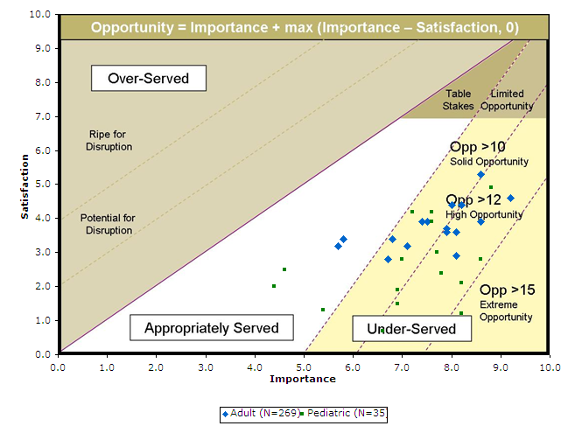
Step 12: Troubleshoot problems with the infusion

Slide 50
Step 12: Troubleshoot problems with the infusion
 | Adult (N=269) |  |  | Pediatric (N=35)
Outcomes | I | S | O | I | S | O
Minimize the likelihood of not being notified of an interruption in the infusion therapy, e.g., patient shuts off alarm, alarm is not heard, etc. | 9.2 | 4.6 | 13.8 | 8.2 | 1.2 | 15.2
Minimize the likelihood of not being able to determine what the problem is when troubleshooting. | 8.6 | 3.9 | 13.3 | 8.6 | 2.8 | 14.4
Minimize the time required to determine if the patient's vessels are the source of a problem with the infusion therapy, e.g., a vein has collapsed, a venous valve is closed, etc. | 8.1 | 2.9 | 13.3 | 8.2 | 2.1 | 14.3
Minimize the amount time that infusion therapy is interrupted when troubleshooting. | 8.1 | 3.6 | 12.6 | 7.8 | 2.4 | 13.2
Minimize the time required to determine if the equipment/supplies are the source of a problem with the infusion therapy, e.g., equipment failure, supply failure, air bubbles, etc. | 7.9 | 3.6 | 12.2 | 8.8 | 4.9 | 12.7
Minimize the likelihood that a problem with infusion therapy is identified incorrectly by the device, e.g., kinked tubing causes an air alarm, denser fluids cause a line occluded alarm, etc. | 7.9 | 3.7 | 12.1 | 6.6 | 0.7 | 12.5
Minimize the likelihood of encountering a dosage alarm in a critical care situation, e.g., soft limit, hard limit | 8.2 | 4.4 | 12.0 | 7.7 | 3.0 | 12.4

Slide 51
Step 12: Troubleshoot problems with the infusion
 | Adult (N=269) |  |  | Pediatric (N=35)
Outcomes | I | S | O | I | S | O
Minimize the likelihood that an unauthorized person controls the pump, e.g., turns off alarms, restarts the pump, stops the pump. | 8.6 | 5.3 | 11.9 | 6.9 | 1.5 | 12.3
Minimize the time it takes to know why an infusion device is alarming. | 8.0 | 4.4 | 11.6 | 6.9 | 1.9 | 11.9
Minimize the time required to verify that adjustments have restored the infusion therapy to the desired state. | 7.5 | 3.9 | 11.1 | 7.6 | 3.9 | 11.3
Minimize the likelihood that an alarm continues when a problem with infusion therapy no longer exists. | 7.1 | 3.2 | 11.0 | 7.0 | 2.8 | 11.2
Minimize the time required to determine the adjustments needed to restore the infusion therapy to the desired state. | 7.4 | 3.9 | 10.9 | 7.6 | 4.2 | 11.0
Minimize the time that an alarm continues while the nurse tries to troubleshoot the issue. | 6.7 | 2.8 | 10.6 | 7.2 | 4.2 | 10.2
Minimize the frequency with which an infusion device has alarms that do not need immediate attention, e.g., due tiny air bubbles, unplugged device, long pause time, temporary obstructions, etc. | 6.8 | 3.4 | 10.2 | 5.4 | 1.3 | 9.5
Minimize the amount of annoyance caused by the sound of alarms, e.g., due to the volume, pitch, pattern, etc. | 5.7 | 3.2 | 8.2 | 4.4 | 2.0 | 6.8
Minimize the amount of waste of the fluids/agents that occurs during troubleshooting, e.g., due to spills, priming, flushing, etc. | 5.8 | 3.4 | 8.2 | 4.6 | 2.5 | 6.7

Slide 52
Step 13: Determine changes to the infusion
Key Messages:
Reducing the amount of time required to make decisions about adjusting therapy is very important for all nurses:
Nurses in Pediatric units are higher opportunities than nurses in Adult units.
Many outcomes are significant opportunities
One extreme opportunity involves having the available knowledge in a timely manner to assess drug interaction with other fluids/agents as part of overall therapy.
Information availability and the time required to obtain the information are also important opportunities

Slide 53
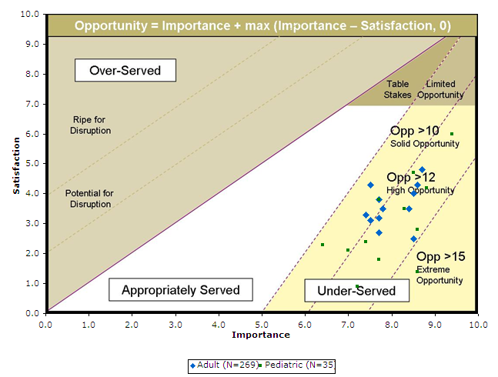
Step 13: Determine changes to the infusion

Slide 54
Step 13: Determine changes to the infusion
 | Adult (N=269) |  |  | Pediatric (N=35)
Outcomes | I | S | O | I | S | O
Minimize the time required to determine how a new fluid/agent that will be added will interact with the other fluids/agents already being delivered to the patient. | 8.5 | 2.5 | 14.5 | 8.6 | 1.4 | 15.8
Minimize the time required to get a decision/order about what to change during the patient's infusion therapy in a critical situation. | 8.4 | 3.5 | 13.3 | 8.6 | 2.8 | 14.4
Minimize the time required to determine how a new fluid/agent that will be added will interact with the equipment/supplies already being used in the infusion therapy. | 8.5 | 4.0 | 13.0 | 7.7 | 1.8 | 13.6
Minimize the time required to determine what changes in the fluid/agent should be made to improve the patient condition, e.g., raise the blood pressure, improve cardiac output, etc. | 8.6 | 4.3 | 12.9 | 7.2 | 0.9 | 13.5
Minimize the time required to get a decision/order about what to change during the patient's infusion therapy after a patient transfer. | 7.7 | 2.7 | 12.7 | 8.8 | 4.2 | 13.4
Minimize the time required to determine what change in the infusion rate or volume should be made to improve the patient condition, e.g., raise the blood pressure, improve cardiac output, etc. | 8.7 | 4.8 | 12.6 | 8.3 | 3.5 | 13.1
Minimize the likelihood that an order is made to change a patient's infusion therapy based on an incomplete understanding of the patient's situation. | 7.7 | 3.2 | 12.2 | 9.4 | 6.0 | 12.8

Slide 55
Step 13: Determine changes to the infusion
 | Adult (N=269) |  |  | Pediatric (N=35)
Outcomes | I | S | O | I | S | O
Minimize the time required to determine what fluids/agents are being given to the patient, e.g., fluid/agent names, doses, etc. | 7.8 | 3.5 | 12.1 | 7.4 | 2.4 | 12.4
Minimize the likelihood of continuing an infusion therapy when it is no longer needed by the patient. | 7.5 | 3.1 | 11.9 | 8.5 | 4.7 | 12.3
Minimize the time required to become aware that a patient needs a change to their infusion therapy, e.g., a different fluid/agent, a different dose, a different schedule, etc. | 7.7 | 3.8 | 11.6 | 7.0 | 2.1 | 11.9
Minimize the time required to get a decision/order for what to change during the patient's infusion therapy. | 7.4 | 3.3 | 11.5 | 7.7 | 3.8 | 11.6
Minimize the time required to determine the rate at which a new fluid/agent should be delivered when added into an existing infusion therapy. | 7.5 | 4.3 | 10.7 | 6.4 | 2.3 | 10.5

Slide 56
Step 14: Adjust the infusion
Key Messages:
Reducing the amount of time required to source materials, prepare the access site, apply the adjustment and restore the patient vitals to target levels is very important for all nurses. Nurses in Pediatric units were consistently higher opportunities than nurses in Adult units.
Working with an existing access site that is difficult to work with is a very high opportunity for all nurses.
Avoiding adverse reactions was an extreme opportunity for nurses in Pediatric units in cases where:
Fluids become depleted after titration adjustments
A dose was missed due to schedule change

Slide 57
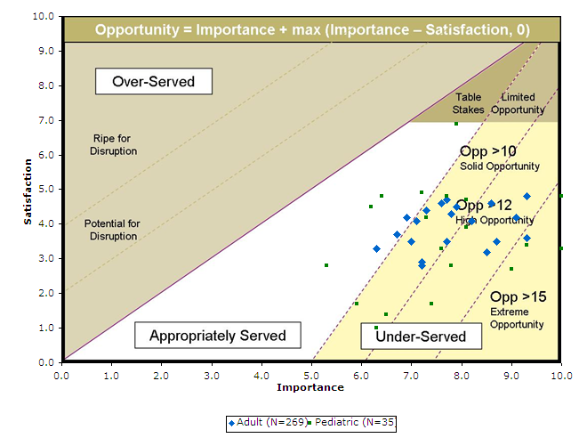
Step 14: Adjust the infusion

Slide 58
Step 14: Adjust the infusion
 | Adult (N=269) |  |  | Pediatric (N=35)
Outcomes | I | S | O | I | S | O
Increase the likelihood of being able to start an additional new infusion therapy on a patient with difficult venous access. | 9.3 | 3.6 | 15.0 | 10.0 | 3.3 | 16.7
Minimize the time required to introduce a new fluid/agent that is needed in an emergency. | 9.1 | 4.2 | 14.0 | 9.0 | 2.7 | 15.3
Minimize the likelihood of missing a dose due to schedule changes. | 8.7 | 3.5 | 13.9 | 9.0 | 2.7 | 15.3
Minimize the likelihood of causing an adverse reaction in the patient while making adjustments to the titration, e.g., due to an overdose, incompatible medications, pain, introduce infection, etc. | 9.3 | 4.8 | 13.8 | 9.3 | 3.4 | 15.2
Increase the likelihood that supplies are available when a fluid is about to be depleted. | 8.5 | 3.2 | 13.8 | 10.0 | 4.8 | 15.2
Minimize the time required to titrate fluid/agents so that the patient to achieves a desired result, e.g., a target blood pressure, a target heart rate, a level of consciousness, etc. | 8.6 | 4.6 | 12.6 | 7.4 | 1.7 | 13.1
Minimize the risk of fluids/agents becoming depleted after titration adjustments are completed. | 8.2 | 4.1 | 12.3 | 7.8 | 2.8 | 12.8

Slide 59
Step 14: Adjust the infusion
 | Adult (N=269) |  |  | Pediatric (N=35)
Outcomes | I | S | O | I | S | O
Minimize the time required to receive replacements for depleted supplies. | 7.7 | 3.5 | 11.9 | 8.1 | 3.9 | 12.3
Minimize the likelihood that a needed replacement fluid/agent is not available. | 7.2 | 2.8 | 11.6 | 7.6 | 3.3 | 11.9
Minimize the time required to receive replacements for depleted fluids/agents. | 7.2 | 2.9 | 11.5 | 6.3 | 1.0 | 11.6
Minimize the time required to restore the infusion therapy to the desired state after an interruption in therapy, e.g., due to an alarm, a bag change, the loss of power, etc. | 7.9 | 4.5 | 11.3 | 6.5 | 1.4 | 11.6
Minimize the likelihood of causing discomfort to the patient when making adjustments to an infusion setup, e.g., tubing, valve settings, labels, etc. | 7.8 | 4.3 | 11.3 | 8.1 | 4.7 | 11.5
Minimize the time required to replenish depleted fluids/agents | 7.7 | 4.7 | 10.7 | 7.7 | 4.8 | 10.6
Minimize the time to re-program an infusion device that is already running when making a change to the settings. | 7.6 | 4.6 | 10.6 | 7.3 | 4.2 | 10.4

Slide 60
Step 14: Adjust the infusion
 | Adult (N=269) |  |  | Pediatric (N=35)
Outcomes | I | S | O | I | S | O
Minimize the time required to identify the equipment/lines that need to be changed when multiple fluids/agents are running. | 7.0 | 3.5 | 10.5 | 5.9 | 1.7 | 10.1
Minimize the time to restart a intentionally discontinued therapy on an infusion device. | 7.3 | 4.4 | 10.2 | 7.2 | 4.9 | 9.5
Minimize the likelihood of upsetting a patient when making changes to the infusion therapy, e.g., tubing changes, programming modifications, etc. | 7.1 | 4.1 | 10.1 | 7.9 | 6.9 | 8.9
Minimize the time required to add a new piece of equipment or a supply to an existing infusion therapy. | 6.7 | 3.7 | 9.7 | 6.4 | 4.8 | 8.0
Minimize the time required to add a new fluid/agent into an existing infusion therapy, e.g., a new medication to the same infusion device, a new fluid to an existing set of infusions, etc. | 6.9 | 4.2 | 9.6 | 6.2 | 4.5 | 7.9
Minimize the time required to replace the tubing located between an infusion device and the patient. | 6.3 | 3.3 | 9.3 | 5.3 | 2.8 | 7.8

Slide 61
Step 15: Document the infusion
Key Messages:
Nurses in Pediatric units were consistently higher with their opportunity scores then nurses in Adult units across all the opportunities.
Ensuring documentation is correct, clear & complete are significant opportunities.
Reducing the amount of time required to find information, record & verify the documented records carries through most of the outcomes. Significant opportunities here.
Reducing time allocated for documentation allows nurses to devote more value-added time towards patient care is a highly significant opportunity.

Slide 62
Step 15: Document the infusion
 | Adult (N=269) |  |  | Pediatric (N=35)
Outcomes | I | S | O | I | S | O
Increase the likelihood that all required documentation is recorded, e.g., to meet regulations, standards, protocols, etc. | 8.4 | 3.4 | 13.4 | 7.9 | 1.4 | 14.4
Minimize the time spent documenting items that have already been documented, i.e., double documentation. | 8.0 | 2.7 | 13.3 | 10.0 | 5.8 | 14.2
Minimize the likelihood of documenting information incorrectly, e.g., the wrong values, names, times, drugs, etc. | 8.5 | 3.8 | 13.2 | 9.4 | 4.9 | 13.9
Minimize the likelihood that previously documented information cannot be read, e.g., due to poor handwriting, smudges, a different language. | 8.4 | 3.8 | 13.0 | 8.0 | 2.4 | 13.6
Minimize the amount of time that documenting the infusion therapy takes away from direct patient care. | 8.1 | 3.6 | 12.6 | 7.7 | 2.3 | 13.1
Minimize the time required to document communication with the physician, e.g., changes that have been made to orders, status of titrations, etc. | 7.3 | 2.1 | 12.5 | 7.7 | 2.3 | 13.1
Minimize the time required to communicate information about the infusion therapy to the next clinician that will care for the same patient. | 7.9 | 3.5 | 12.3 | 8.1 | 3.4 | 12.8

Slide 63
Step 15: Document the infusion
 | Adult (N=269) |  |  | Pediatric (N=35)
Outcomes | I | S | O | I | S | O
Minimize the time required to find the information needed to evaluate the patient's condition. | 7.7 | 3.6 | 11.8 | 7.2 | 2.2 | 12.2
Minimize the amount of documentation that is not double documentation but has no bearing on the patient care. | 7.0 | 2.4 | 11.6 | 9.5 | 7.1 | 11.9
Minimize the time required to determine if the orders for infusion therapy have been followed. | 7.8 | 4.6 | 11.0 | 7.0 | 2.8 | 11.2
Minimize the frequency with which contradictory pieces of information about the infusion therapy are encountered. | 7.4 | 3.8 | 11.0 | 8.2 | 5.3 | 11.1
Minimize the time required to document the assessment of the patient's condition. | 7.3 | 3.9 | 10.7 | 7.9 | 5.3 | 10.5
Minimize the time required to document the patient's reactions to the infusion therapy, e.g., benefits achieved, adverse reactions, etc. | 7.1 | 3.8 | 10.4 | 6.2 | 2.3 | 10.1

Slide 64
Step 15: Document the infusion
 | Adult (N=269) |  |  | Pediatric (N=35)
Outcomes | I | S | O | I | S | O
Minimize the time required to document information about the access site used for the infusion therapy, e.g., the materials used, the location used, etc. | 6.6 | 2.9 | 10.3 | 6.7 | 3.8 | 9.6
Minimize the time required to document the attributes of infusion therapy, e.g., the schedule, the rate, the dosage, etc. | 7.1 | 3.9 | 10.3 | 5.1 | 0.7 | 9.5
Minimize the time required to document the patient output during the infusion therapy, e.g., urine, wound drainage, vomit, etc. | 6.6 | 3.2 | 10.0 | 5.8 | 2.7 | 8.9
Minimize the time required to document the fluids/agents used in the infusion therapy. | 6.5 | 3.8 | 9.2 | 5.6 | 3.5 | 7.7
Minimize the time required to document the equipment/supplies used in the infusion therapy. | 4.9 | 2.9 | 6.9 | 3.5 | 4.2 | 3.5

Slide 65
Step 16: Discontinue the infusion
Key Messages:
Nurses in Adult & Pediatric units have consistent needs to:
Avoid discontinuing therapy at the wrong time
Avoid discontinuing the wrong therapy
Avoid continuing the therapy when no longer necessary
Minimizing infection is a significant opportunity (esp. for nurses in Adult units)

Slide 66
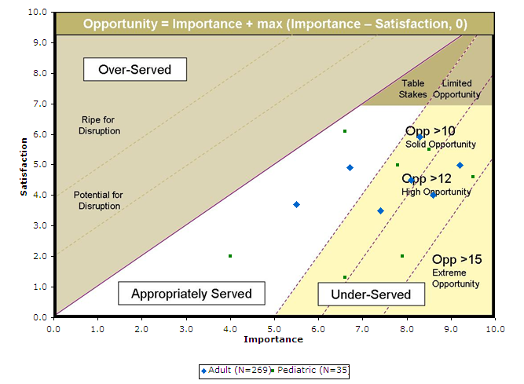
Step 16: Discontinue the infusion

Slide 67
Step 16: Discontinue the infusion
 | Adult (N=269) |  |  | Pediatric (N=35)
Outcomes | I | S | O | I | S | O
Minimize the likelihood of introducing an infection in the patient when discontinuing an infusion. | 9.2 | 5.0 | 13.4 | 9.5 | 4.6 | 14.4
Minimize the likelihood of discontinuing the wrong fluid/agent. | 8.6 | 4.0 | 13.2 | 7.9 | 2.0 | 13.8
Minimize the likelihood that the infusion therapy is continued unnecessarily. | 8.1 | 4.5 | 11.7 | 6.6 | 1.3 | 11.9
Minimize the likelihood of discontinuing an infusion at the wrong time. | 7.4 | 3.5 | 11.3 | 8.5 | 5.5 | 11.5
Minimize the likelihood that fluids/agents will continue to flow after the infusion has been stopped. | 8.3 | 5.9 | 10.7 | 7.8 | 5.0 | 10.6
Minimize the time to stop an infusion that is no longer required. | 6.7 | 4.9 | 8.5 | 6.6 | 6.1 | 7.1
Minimize the time required to obtain an order to discontinue infusion therapy. | 5.5 | 3.7 | 7.3 | 4.0 | 2.0 | 6.0

Slide 68
Step 17: Dispose of supplies
Key Messages:
Nurses in Adult & Pediatric units have consistent needs to:
Avoid risk of exposure to hazardous materials and avoid injury to all parties (practitioners and patients)
Reduce the potential for theft of controlled substances
Ensure disposal procedures are compliant with policies.

Slide 69
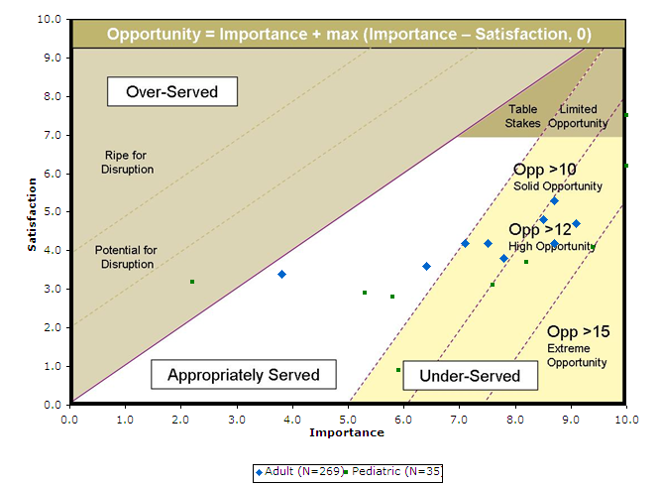
Step 17: Dispose of supplies

Slide 70
Step 17: Dispose of supplies
 | Adult (N=269) |  |  | Pediatric (N=35)
Outcomes | I | S | O | I | S | O
Minimize the likelihood that a person is exposed to caustic agents during the disconnecting and disposal of them, e.g., chemotherapy fluids, biohazardous agents, etc. | 9.1 | 4.7 | 13.5 | 9.4 | 4.1 | 14.7
Minimize the likelihood that a person is exposed to biohazardous materials during the disposal of infusion therapy supplies. | 8.7 | 4.2 | 13.2 | 10.0 | 6.2 | 13.8
Minimize the likelihood that controlled substances can be stolen from a patient's infusion therapy, e.g., narcotics, paralytics, ketamines, etc. | 8.5 | 4.8 | 12.2 | 8.2 | 3.7 | 12.7
Minimize the likelihood of a sharps injury during the disposal of infusion therapy supplies e.g., a needle puncture, a cut, etc. | 8.7 | 5.3 | 12.1 | 10.0 | 7.5 | 12.5
Increase the likelihood of complying with the policies for disposal of supplies. | 7.8 | 3.8 | 11.8 | 7.6 | 3.1 | 12.1
Minimize the time required to dispose of caustic agents, e.g., chemotherapy fluids, etc. | 7.5 | 4.2 | 10.8 | 5.9 | 0.9 | 10.9
Minimize the time required to dispose of controlled substances, e.g., narcotics, paralytics, ketamines, etc. | 7.1 | 4.2 | 10.0 | 5.8 | 2.8 | 8.8
Minimize the time required to dispose of biohazard materials, e.g., to find the right place, find the necessary materials, etc. | 6.4 | 3.6 | 9.2 | 5.3 | 2.9 | 7.7
Minimize the time required to dispose of general supplies, e.g., tubing, clamps, tape, bags, etc. | 3.8 | 3.4 | 4.2 | 2.2 | 3.2 | 2.2

Slide 71
Related Jobs
Key Messages:
These are the other jobs the nurse is trying to get done while performing the job of infusing therapeutic agents
The nurses in the Adult units rated these opportunities higher then the nurses in Pediatric units
Of the 28 Social & Emotional Jobs, 14 are opportunities

Slide 72
Adjacent Jobs Total Market
 | Adult (N=269) |  |  | Pediatric (N=35)
Q2 - Adjacent Jobs | I | S | O | I | S | O
Address urgent patient care needs | 9.7 | 5.0 | 14.4 | 9.2 | 4.7 | 13.7
Ensure the comfort of the patient | 9.3 | 5.6 | 13.0 | 9.2 | 5.6 | 12.8
Learn about new medications | 8.6 | 4.5 | 12.7 | 8.4 | 4.5 | 12.3
Monitor other procedures being performed on the patient | 9.1 | 5.5 | 12.7 | 9.9 | 7.8 | 12.0
Learn about a medicine-related topic, e.g., a protocol | 8.2 | 4.6 | 11.8 | 9.3 | 6.7 | 11.9
Inform other medical personnel about the patient's status | 8.1 | 4.8 | 11.4 | 7.8 | 4.5 | 11.1
Educate the patient/family about the procedure being performed | 8.4 | 5.4 | 11.4 | 7.3 | 3.5 | 11.1
Educate patient/family members on care post discharge | 7.9 | 4.4 | 11.4 | 7.5 | 4.1 | 10.9
Document patient care not related to infusion therapy | 7.5 | 3.9 | 11.1 | 6.9 | 3.3 | 10.5
Field questions from patients/patient-caregivers | 7.8 | 4.5 | 11.1 | 7.9 | 5.3 | 10.5
Monitor other patients | 7.8 | 4.6 | 11.0 | 7.9 | 5.3 | 10.5
Coach/educate the patient | 7.8 | 4.8 | 10.8 | 7.8 | 5.4 | 10.2
Prepare the patient for other exams/procedures that will happen while on the current infusion | 7.6 | 4.5 | 10.7 | 7.7 | 5.6 | 9.8
Provide emotional support to the patient/family | 7.6 | 4.8 | 10.4 | 7.6 | 5.5 | 9.7
72

Slide 73
Adjacent Jobs Total Market
 | Adult (N=269) |  |  | Pediatric (N=35)
Q2 - Adjacent Jobs | I | S | O | I | S | O
Give other medications; e.g., oral, anal | 7.7 | 5.1 | 10.3 | 6.4 | 3.6 | 9.2
Assist the patient with mobility/ambulation | 6.7 | 3.6 | 9.8 | 6.2 | 3.6 | 8.8
Educate colleagues | 7.0 | 4.7 | 9.3 | 5.9 | 3.2 | 8.6
Ensure adequate stock of infusion supplies | 6.4 | 4.3 | 8.5 | 5.8 | 3.2 | 8.4
Transport the patient to other hospital departments | 5.6 | 3.6 | 7.6 | 5.1 | 2.5 | 7.7
Provide feedback regarding infusion equipment | 5.4 | 3.6 | 7.2 | 6.2 | 5.1 | 7.3
Plan patient discharge | 5.3 | 3.4 | 7.2 | 3.3 | 0.8 | 5.8
Field questions from colleagues about other patients | 5.5 | 3.9 | 7.1 | 4.1 | 2.6 | 5.6
Prepare the equipment for the next use, e.g., maintain it, test it, replenish supplies/power, etc. | 5.1 | 3.2 | 7.0 | 4.1 | 2.7 | 5.5
Clean the infusion equipment | 5.3 | 3.9 | 6.7 | 3.8 | 2.7 | 4.9
Field phone calls and handle pages | 4.6 | 2.9 | 6.3 | 3.7 | 2.5 | 4.9
Help get supplies for other nurses | 4.9 | 3.6 | 6.2 | 3.1 | 1.3 | 4.9
Monitor pages | 4.5 | 3.2 | 5.8 | 3.6 | 2.9 | 4.3
Track infusion system inventory | 3.4 | 2.9 | 3.9 | 3.3 | 5.2 | 3.3
73

Slide 74
Social & Emotional Jobs
Key Messages:
Of the 21 Social & Emotional Jobs, 20 are important opportunities (over half of them are extreme)
Notes:
Importance is rated for Social & Emotional Jobs
Satisfaction is not rated
The importance was the same for both nurses in Adult & Pediatric units in the hospital

Slide 75
Social & Emotional Jobs Total Market
Social & Emotional Jobs | Importance | Opportunity | Rank
Be perceived as trustworthy | 9.8 | 19.6 | 1
Be perceived as protecting the patient's safety | 9.4 | 18.8 | 2
Be perceived as competent | 9.3 | 18.6 | 3
Be perceived as knowledgeable | 9.0 | 18.0 | 4
Be perceived as caring | 8.9 | 17.8 | 5
Avoid feeling disorganized | 8.8 | 17.6 | 6
Be perceived as sincere | 8.7 | 17.4 | 7
Be perceived as collaborative | 8.5 | 17.0 | 8
Be perceived as up to date | 8.5 | 17.0 | 9
Avoid feeling frustrated | 8.0 | 16.0 | 10
Avoid feeling a sense of mistrust | 7.9 | 15.8 | 11
Avoid feeling inadequate | 7.7 | 15.4 | 12
Avoid feeling stressed | 7.3 | 14.6 | 13
Avoid feeling irritated | 7.2 | 14.4 | 14
Be perceived as happy in my job | 7.1 | 14.2 | 15
Feel a sense of accomplishment | 7.0 | 14.0 | 16
Avoid feeling stupid | 7.0 | 14.0 | 17
Avoid feeling uncomfortable/insecure | 6.9 | 13.8 | 18
Feel appreciated | 5.6 | 11.2 | 19
Avoid feeling embarrassed | 5.5 | 11.0 | 20
Avoid being perceived as a servant | 3.6 | 7.2 | 21
75

Slide 76
Project Methodology
Overview

Slide 77
Key Milestones
Define domain model
Define customer focus methodology
Define action plan to capture unmet needs
Begin interviews with key stakeholders
Complete qualitative analysis
Draft survey for quantitative analysis
Conduct survey and capture data
Present recommendations
Based on the Strategyn Methodology (see next slides)

Slide 78
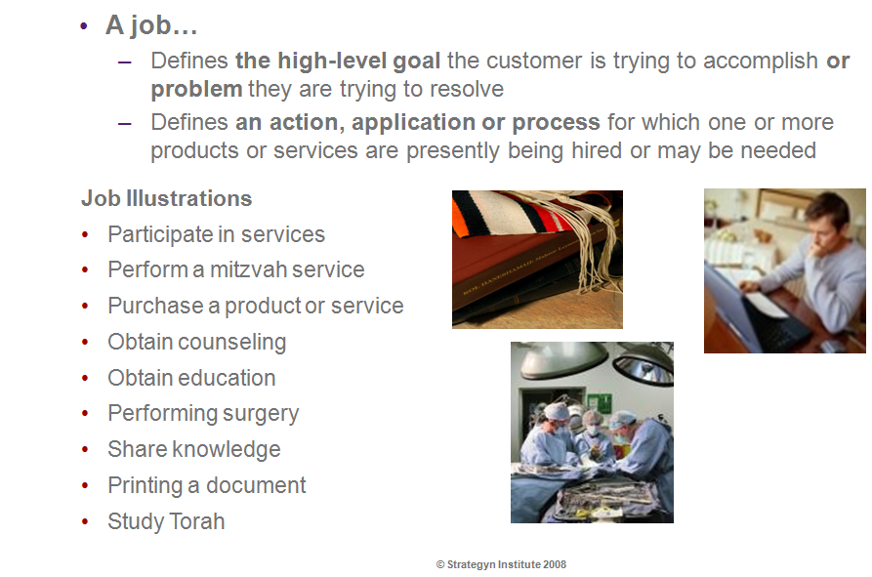
What is a Job ?

Slide 79
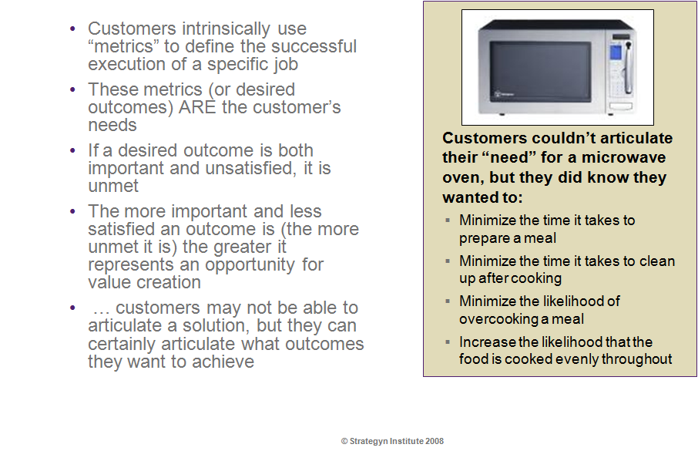
What are outcomes ?

Slide 80
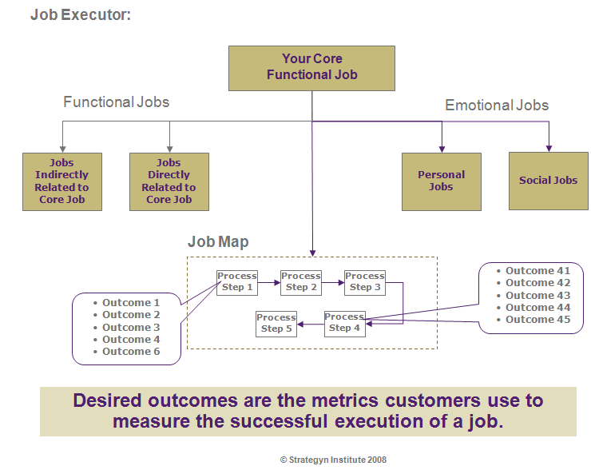
Model for Relating Jobs & Outcomes

Slide 81
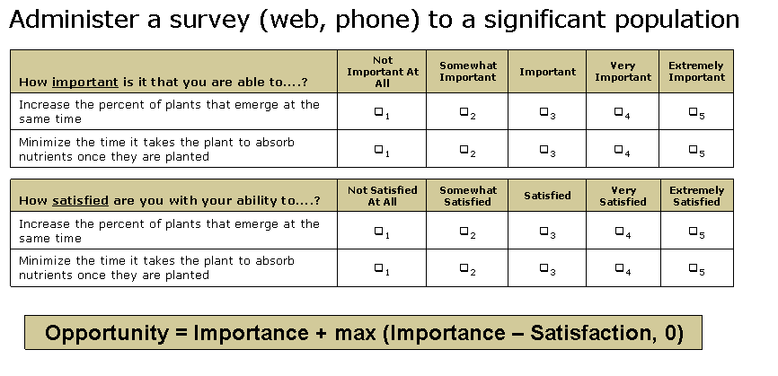
Capturing & Measuring Value

Slide 82
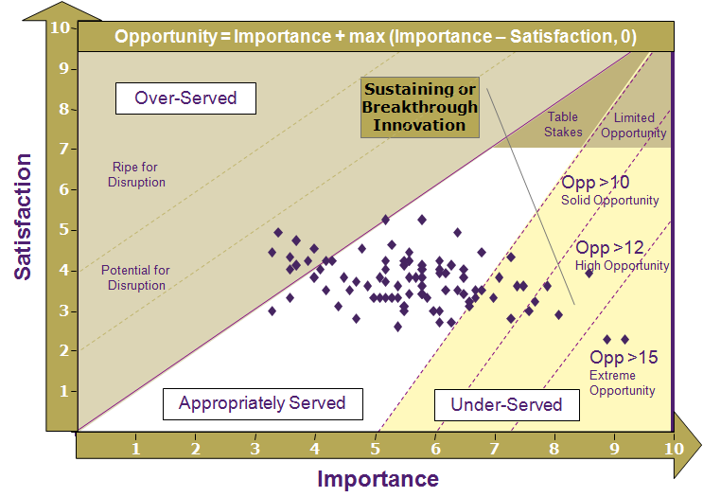
Identifying & Prioritizing Opportunities

Slide 83
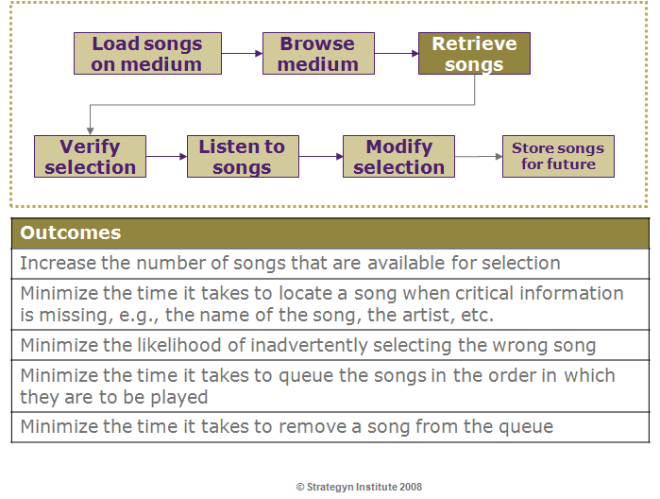
Example: Job of Storing & Retrieving Music

Slide 84
Thank You

